Slide 1
Who are SE2
Friday June 15th 2018

Slide 2
Core Values
From the beginning, SE2’s success has been built by innovative, passionate leaders, committed to making a dramatic difference by taking risks, thinking creatively, and facing difficult problems with excitement and energy. All SE2 associates share this heritage and it is the basis for the values that drive our business.
From the beginning, SE2’s success has been built by innovative, passionate leaders, committed to making a dramatic difference by taking risks, thinking creatively, and facing difficult problems with excitement and energy. All SE2 associates share this heritage and it is the basis for the values that drive our business.

Slide 3


What we do
Financial Product Administration
for Life Insurance and Annuity Companies
Technology Services
Call & Processing Centers
Technical Support
Third Party Administrator/Business Processing Outsourcer

Slide 4




Our Market Positioning
Help clients launch new annuity products faster
Up to a third faster and at a third less cost than over-taxed internal teams and outmoded legacy systems
Continue to grow annuity block with new conversions
Leverage our market leadership to grow annuity block of business
Invest in new Digital & Life capabilities
Leverage capital investment and vendor echo system to build the industry disrupting “No Touch” Digital Life platform
Grow Life block with strategic partnerships and anchor clients
Be selective on partnerships around Life to anchor clients and strategic partnerships

Slide 5
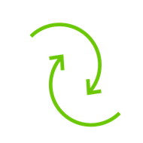
Business Operations and Services: 2018: Key Initiatives
Enhanced Quality
Client centric culture/mindset
Speed, accuracy, completeness
Core process / model aligned
Value felt by our clients
Productivity Optimization
Efficiency and effectiveness
Resource management / load balancing
End-to-end lifecycle focus and view
Robotics/RPA & OnBase/BRE initiatives
Technology Alignment
Incident management
Release management
Intake/Delivery projects
SE2 capital investment program
Transformation to Target Model
Horizontal coordination and best practice solutions
Core process optimization via centers of excellence
Site integration, coordination, and footprint expansion
Dependability/reliability & scalability/sustainability
Core Process Centers of Excellence
Scope across all foundational disciplines and areas
Optimized/standardized model - best practice solutions
Associate SME development and career paths
Subject matter expertise - teams, & associates

Slide 6
Our Company

Slide 7


The Realization of SE2
2003
2005
2000
SE2 Launches
Could there be segregated
functionality &“multi-tenancy”?
Would this benefit other companies?
First Customer
Notes:
In approximately 2000 SB leaders asked determined it would be beneficial for other life insurance and annuity companies.
Between 2002-2005, the technology team members began modifying and testing for segregated functionality – could data be separated? – And could the separation of data allow for multi-tenancy. – For instance: Can multiple companies use the system and keep data separate from other companies’ data.
Leaders determined it could. The realization that the technology framework could be used industry-wide laid the foundation for this separate company.
At this time we have scalable technology - our unique multi-tenant platform drives down per policy cost.
In 2005, se² was incorporated as a separate entity.
Our first client was Goldman Sachs.
Our Name: Our name means “Service End to End” – Service from a product’s inception through-out the life to the product.

Slide 8


Our Purpose
SE2
Service – End to End
Service – End to End
Who is SE2?
BPO & More
Notes:
Understanding what we do, how we serve our clients, really defines our name.
We offer service from the inception of a product throughout the life of a life insurance or annuity product.
Service- end to end…

Slide 9













A Rapidly Expanding List of Clients
Representative List

Slide 10

















Why Clients Use Us
Achieve Transformation Benefits with Lower Risk
Support Distribution
Reduce Unit and Overall Costs
√
Launch New Products Quickly and Efficiently
Flexible Scalability
Improve Persistency
Reduce Compliance Risk
Improve
Profitability
Product Launch
Reduce Conversion Risk
Reduce
Risk
Electronic Processing
Reduce Reserve Requirements
Improve Speed to Market
Modernize Technology / Retire Systems
Improve Customer Service
Improve
Service
Positioning
for Success
Improve Distributor Experience
Focus on Core: Product, Distribution, Risk Management
Ability to Scale
Notes:
Because of our multi-tenancy and our technology being specifically tailored to life insurance products, we provide our clients with five distinct reasons for choosing us.
We improve service. Our teams and training are dedicated to higher/better levels of support. Teams can share knowledge and skills, trainers can be dedicated.
We improve profitability. We reduce unit and over costs and reduce reserve requirements.
We reduce risk. Any type of change creates amounts of risks. Our technology and personnel are customized and dedicated to ensuring risk reduction.
We help launch products quicker and more efficiently. Our flexible technologies and electronic processing allow for speed to market.
We help our clients position for success. We have modern technology, the ability to scale and we are solely focused on product, distribution, and risk management.

Slide 11
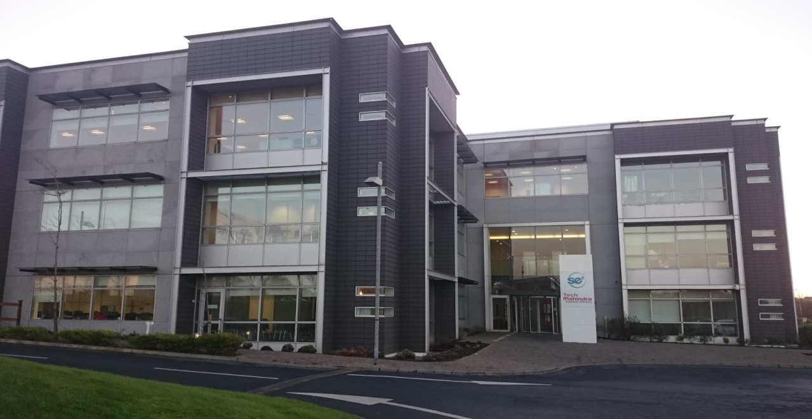
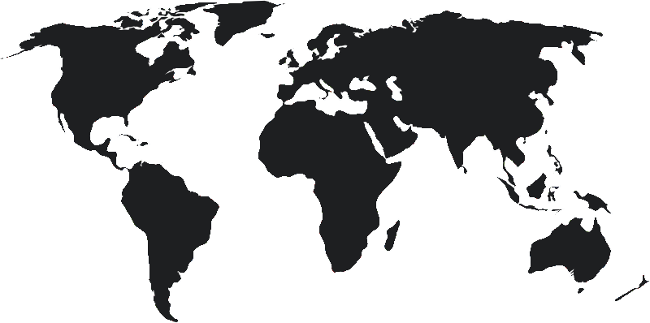
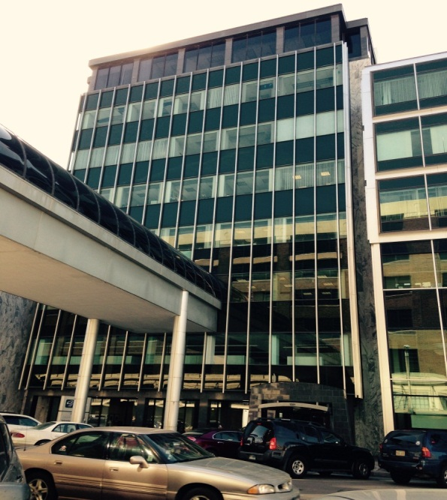
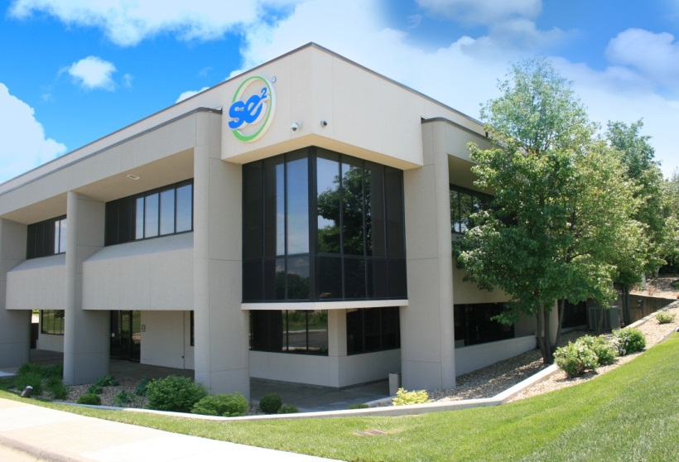
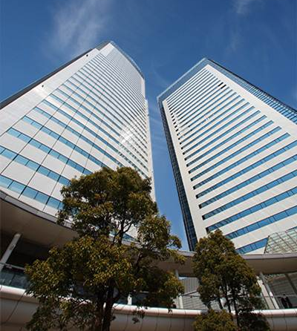
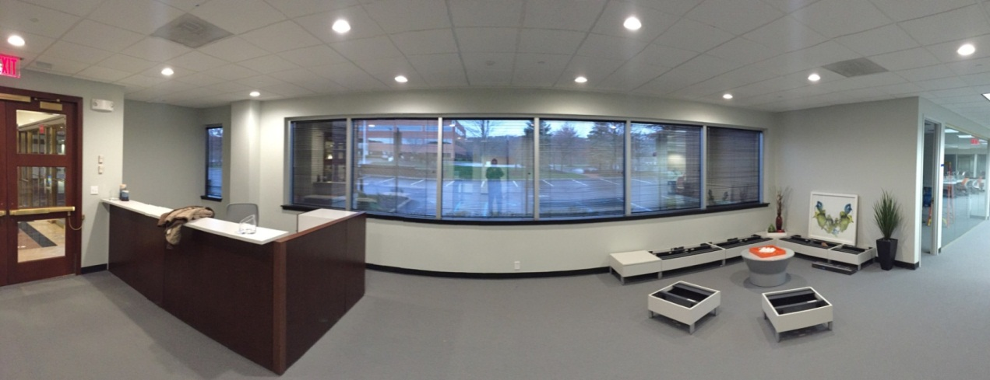
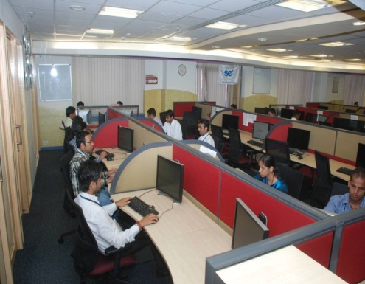
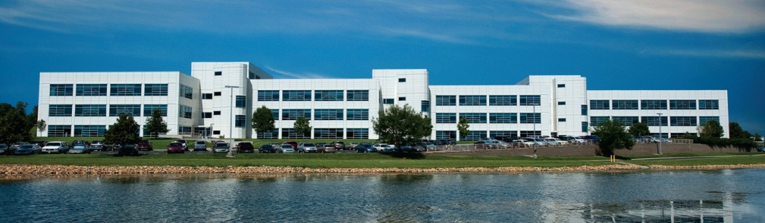


SE2 Global Delivery
Processing Center
107 Total Associates & Managers
*73IT Professionals
*30 Call & Processing
2 Finance and Admin.
1 HR Manager
1 Learning & Development
Acquired Fall 2015
Approximately 57 Delivery Associates
1 Office Manager
Opened December 2015
12-15 Lincoln Benefit Life Call Center Associates
Established February, 2015
Three Locations
IT Staff Augmentation
Disaster Recovery
Processing Center
Corporate Headquarters
Lincoln, Nebraska
Mid-West
Waterford, Ireland
Bridgewater, New Jersey
NTT Data - India
Topeka, Kansas
Notes:
Our home is in Topeka, Kansas where we have two separate locations. Corporate Home Office located at 1300 Arrowhead. Referred as Arrowhead or even 1300. Its houses leadership and some call/processing teams as well as many support teams. This small building houses less than 10% of our associates.
Security Benefit Building – also known as SB Main Campus or 6th Street Campus. This large campus features a café, training center, and more than 70% of our associates. Our parent company is Security Benefit. We rent space and take advantage of the it’s size to accommodate many of our needs.
Other locations include:
Se2 – Lincoln Nebraska – This particular site houses a call and process center specific to only to Lincoln Benefit Life. It’s directly north of Topeka. Driving time would be about three hours. Lincoln Benefit Life requested that their call and processing center be housed near their home location.
Se2- Bridgewater – Located in Bridgewater, NJ is another recent addition. In late 2015 se2 chose to secure a location central to the Life Insurance industry. Located near Bridgewater are many Life Insurance companies. In this location, we are a presence in the Industry, tap into local talent found in this area, and court many potential new clients.
Se2 –Waterford – Located in Ireland. Se2 purchased the entity in late 2015. This group of highly skilled personnel helped onboard one of our clients to the se2 platform. This location also helps support our 24/7 global delivery model.
Points of interest:
Kansas City, Missouri - houses a business continuity and disaster recovery location.
NTT – located in India. se2 has engaged NTT Data, Inc to provide transaction, reporting, and accounting support services. Although they are not se2, they are business

Slide 12
Technologies

Slide 13
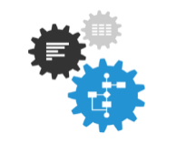
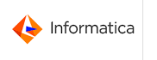






THEMES
ENABLERS
Digital Themes and Technology Enablers Driving the Journey Towards Digital Administration at SE2
Digitization
Automation
Analytics
Omni Channel
Real Time
Self Service
Services / APIs
No / Low Touch
Reduce Processing Time
Business Insights
User Personalization
Next Best Action
Additional Digital Tools & Technologies
Robotics
Rules Engine
Application Integration Network
Workflow
MuleSoft

Slide 14
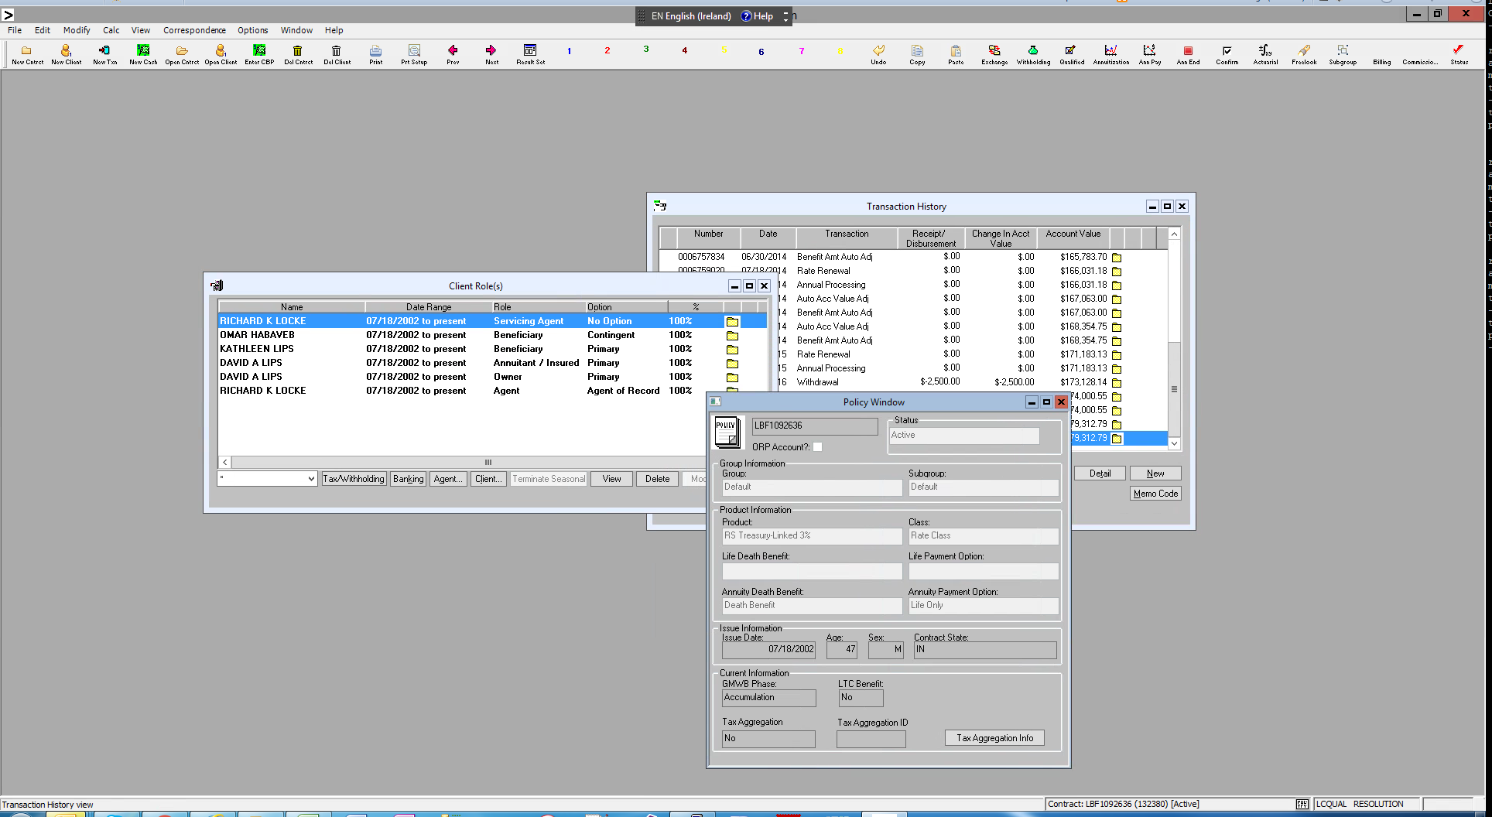
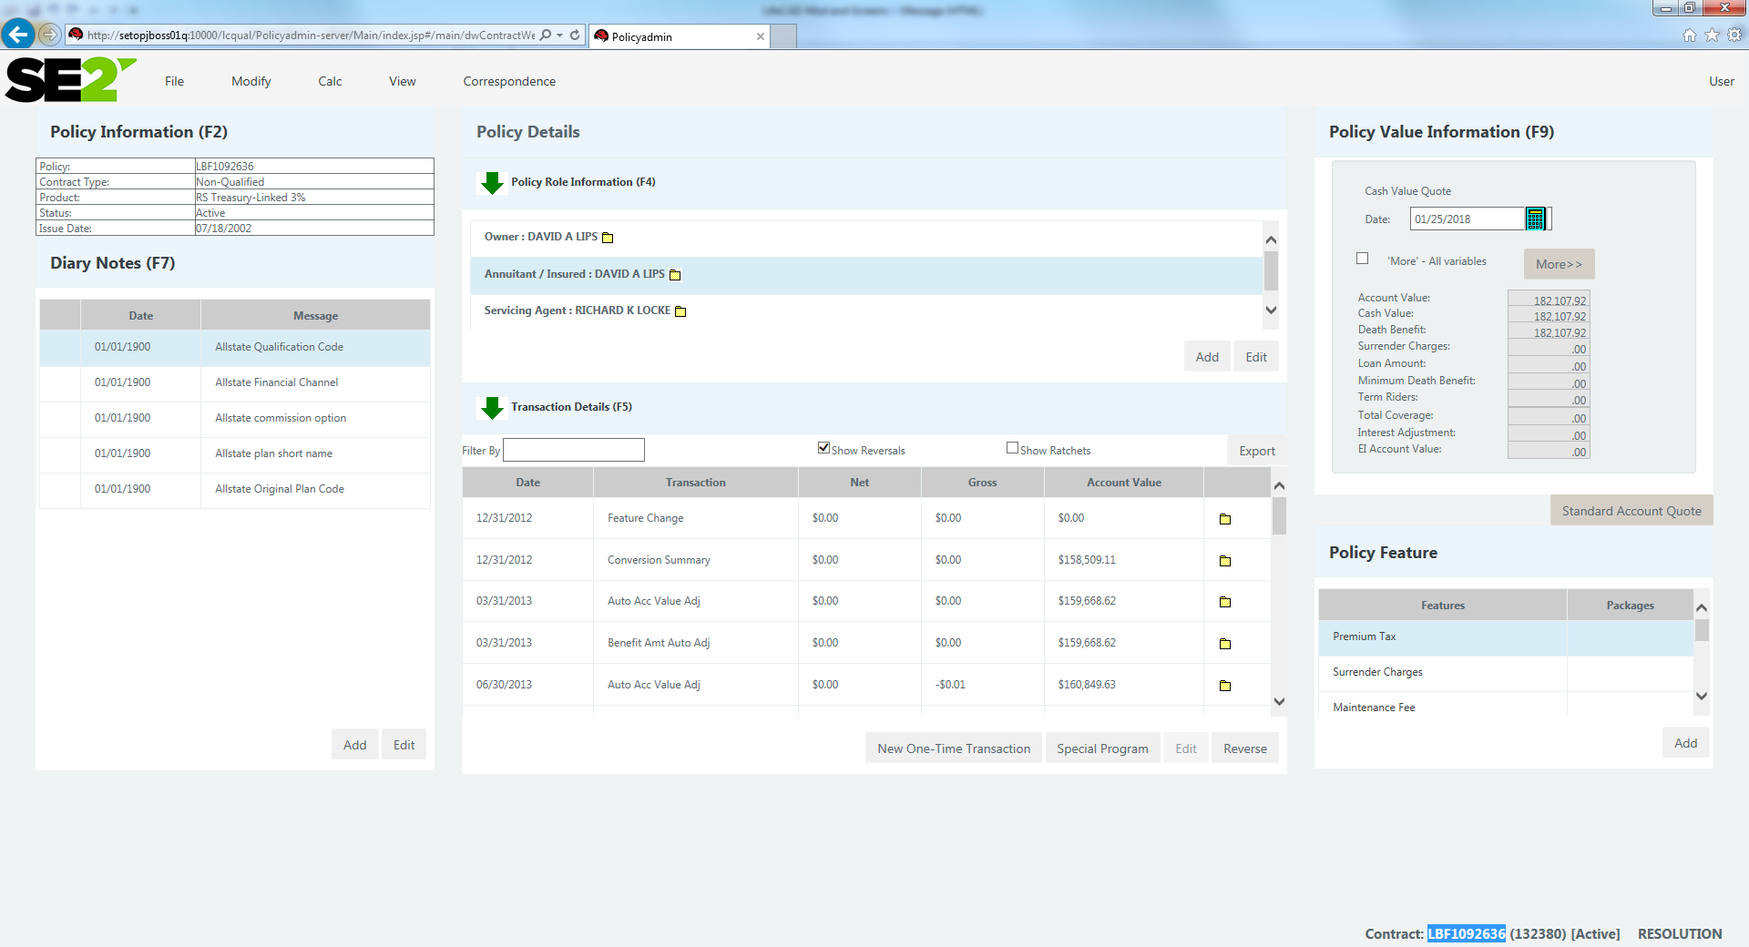
LifeCad Technology Stack
Current Stack
PowerBuilder
C
Visual Studio (C / C++)
Oracle
Windows & Solaris
Future State Stack
Java Services (Service enablement)
JBoss
ESB (MuleSoft / Active MQ)
Oracle on Solaris
Linux
UI → Angular JS

Slide 15
Domain

Slide 16
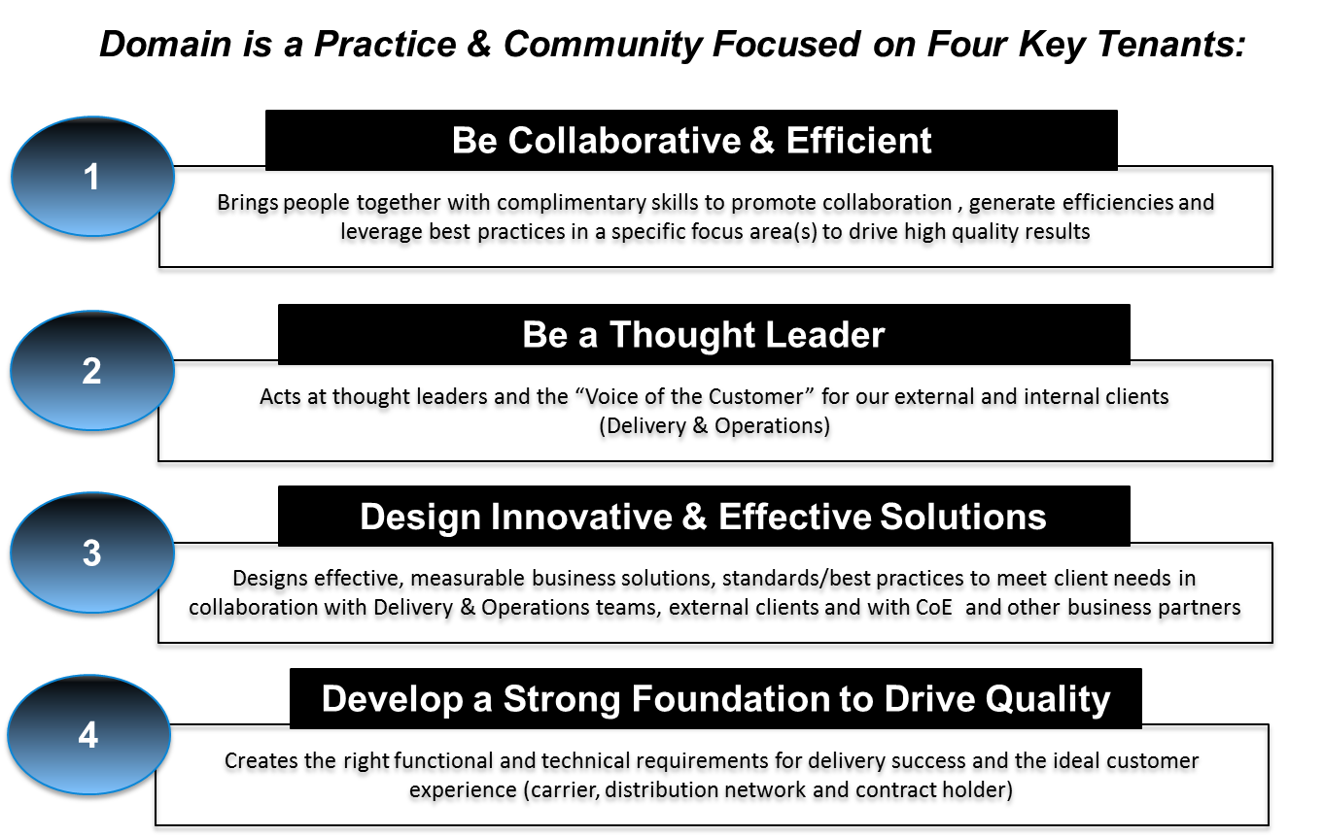
What is Domain?

Slide 17
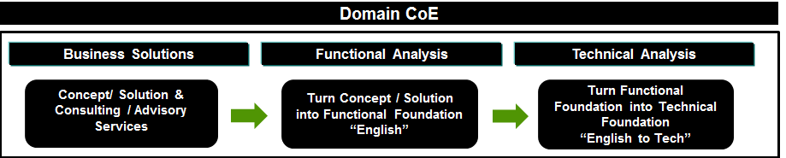
Domain – Centre of Excellence – SE2
Business Knowledge – Insurance Industry
Knowledge of SE2 Systems, Processes, Products
Technical Skills
Professional Skills/ Soft Skills

Slide 18
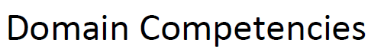
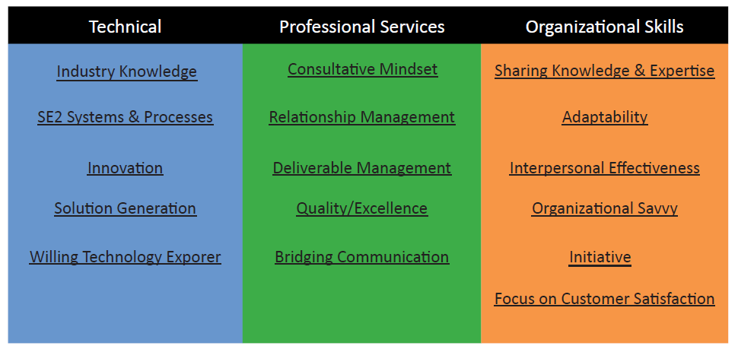

Slide 19
What has SE2 ever done for me?
An introduction role in IT
Training and Development
Mentoring
Travel
A growing company
Working in a multi-national, multi-site organisation all in beautiful Waterford

Slide 20
Ireland Site

Slide 21
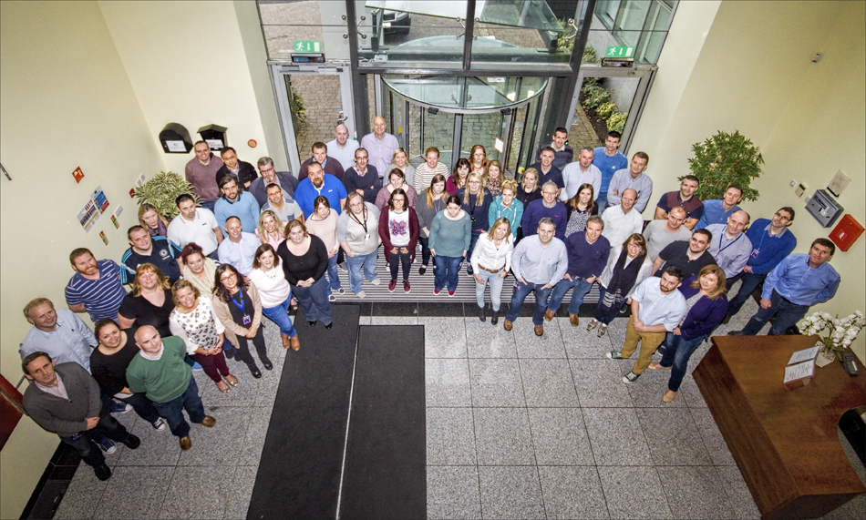
Waterford Office
111 Total Associates & Managers
*77 IT Professionals
*30 Call & Processing
2 Finance and Admin
1 HR Manager
1 Learning & Development
*107 Permanent Employees
* 4 Contract Employees
Notes:
Questions
Break

Slide 22



Background to the Waterford Entity
1998
2013
2015
Sun Life launches an offshore
location in Waterford, Ireland
Delaware Life purchases Sun Life’s
life and annuity block of business
Ireland team converts
Block to se²’s systems
se² purchases Waterford Operation
Notes:
Omit slide if presenting to non-Ireland groups.
1998 Operations in Waterford launches with 400 IT and Operations Staff working on life, annuity, and group platforms for Sun Life Financial.
2013: Delaware Life owned by Guggenheim partners purchases Sun Life’s Annuity and Life Insurance block of business in 2013.
The Waterford team helps convert the block of business to se2’s systems.

Slide 23






SE2 Ireland Roles and Purposes
Project Management
Production Support
Requirements
Development
Testing
Design

Slide 24

SE2 Ireland IT
Data Integration
Web Development
Big Microsoft SQL Server operation
SSIS
.NET/VB/C#
Java Script
JQuery/Angular
HTML 5, CSS3

Slide 25
Culture and Events

Slide 26
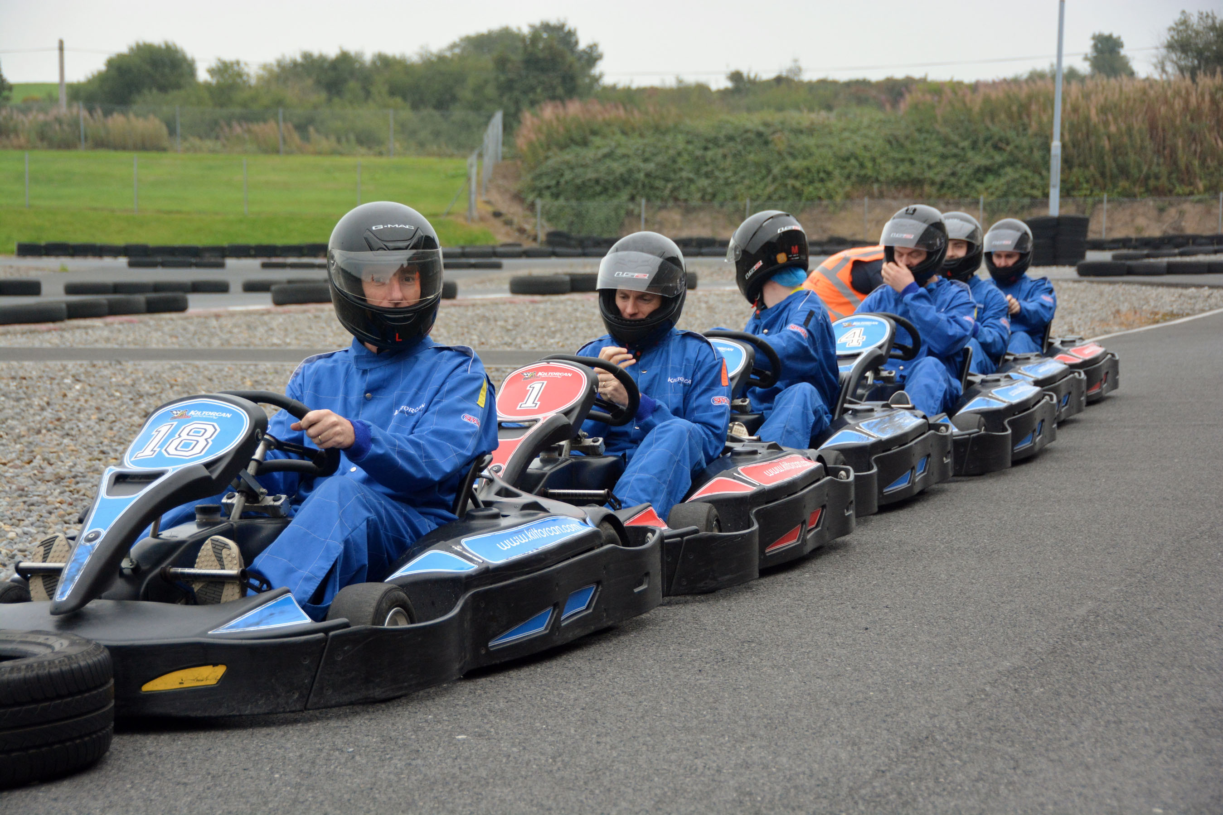
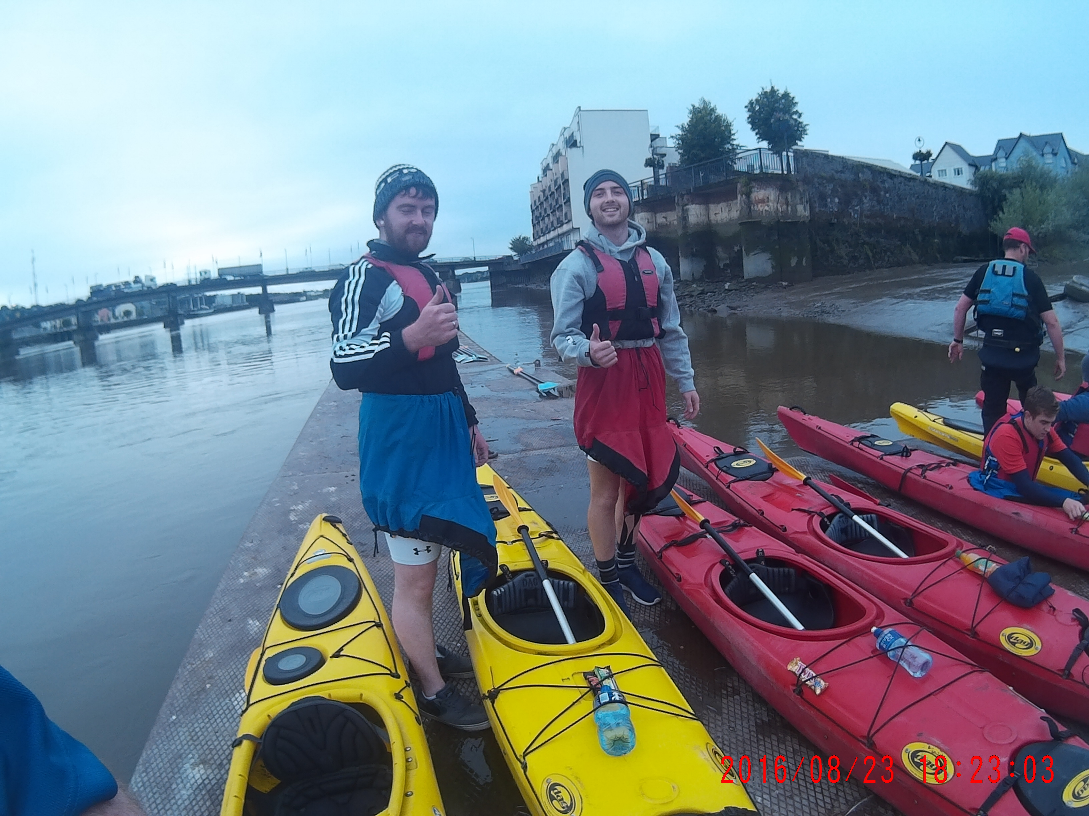
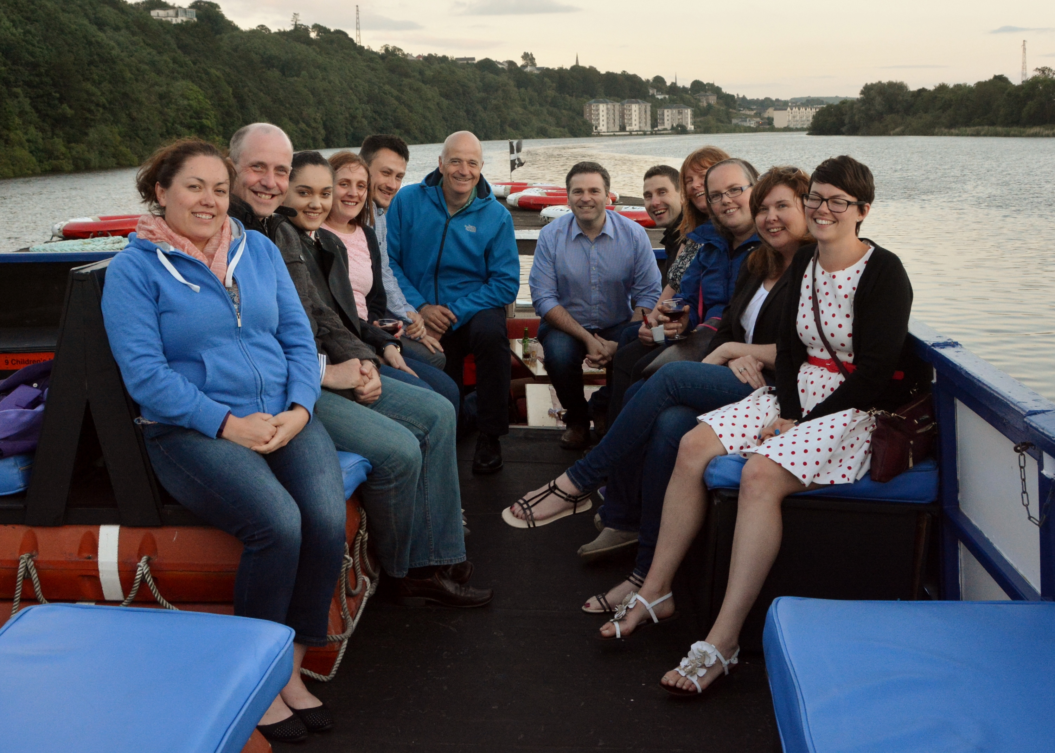
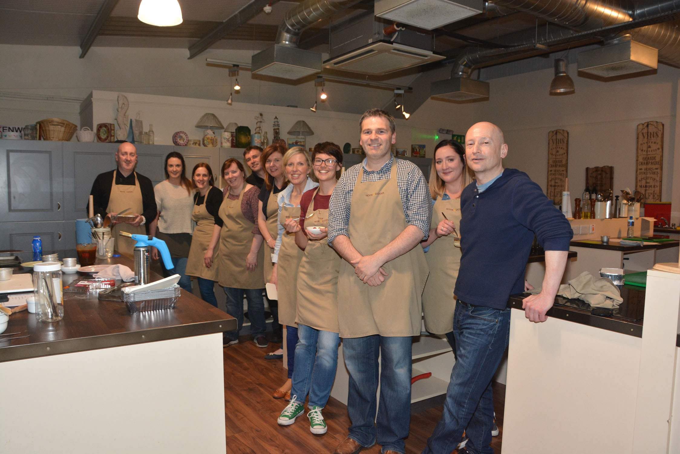
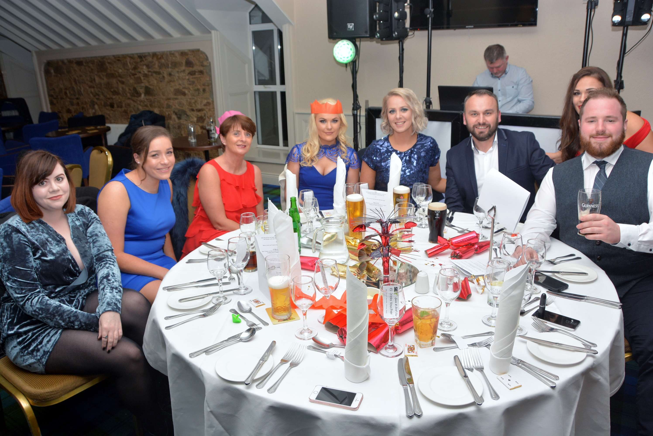
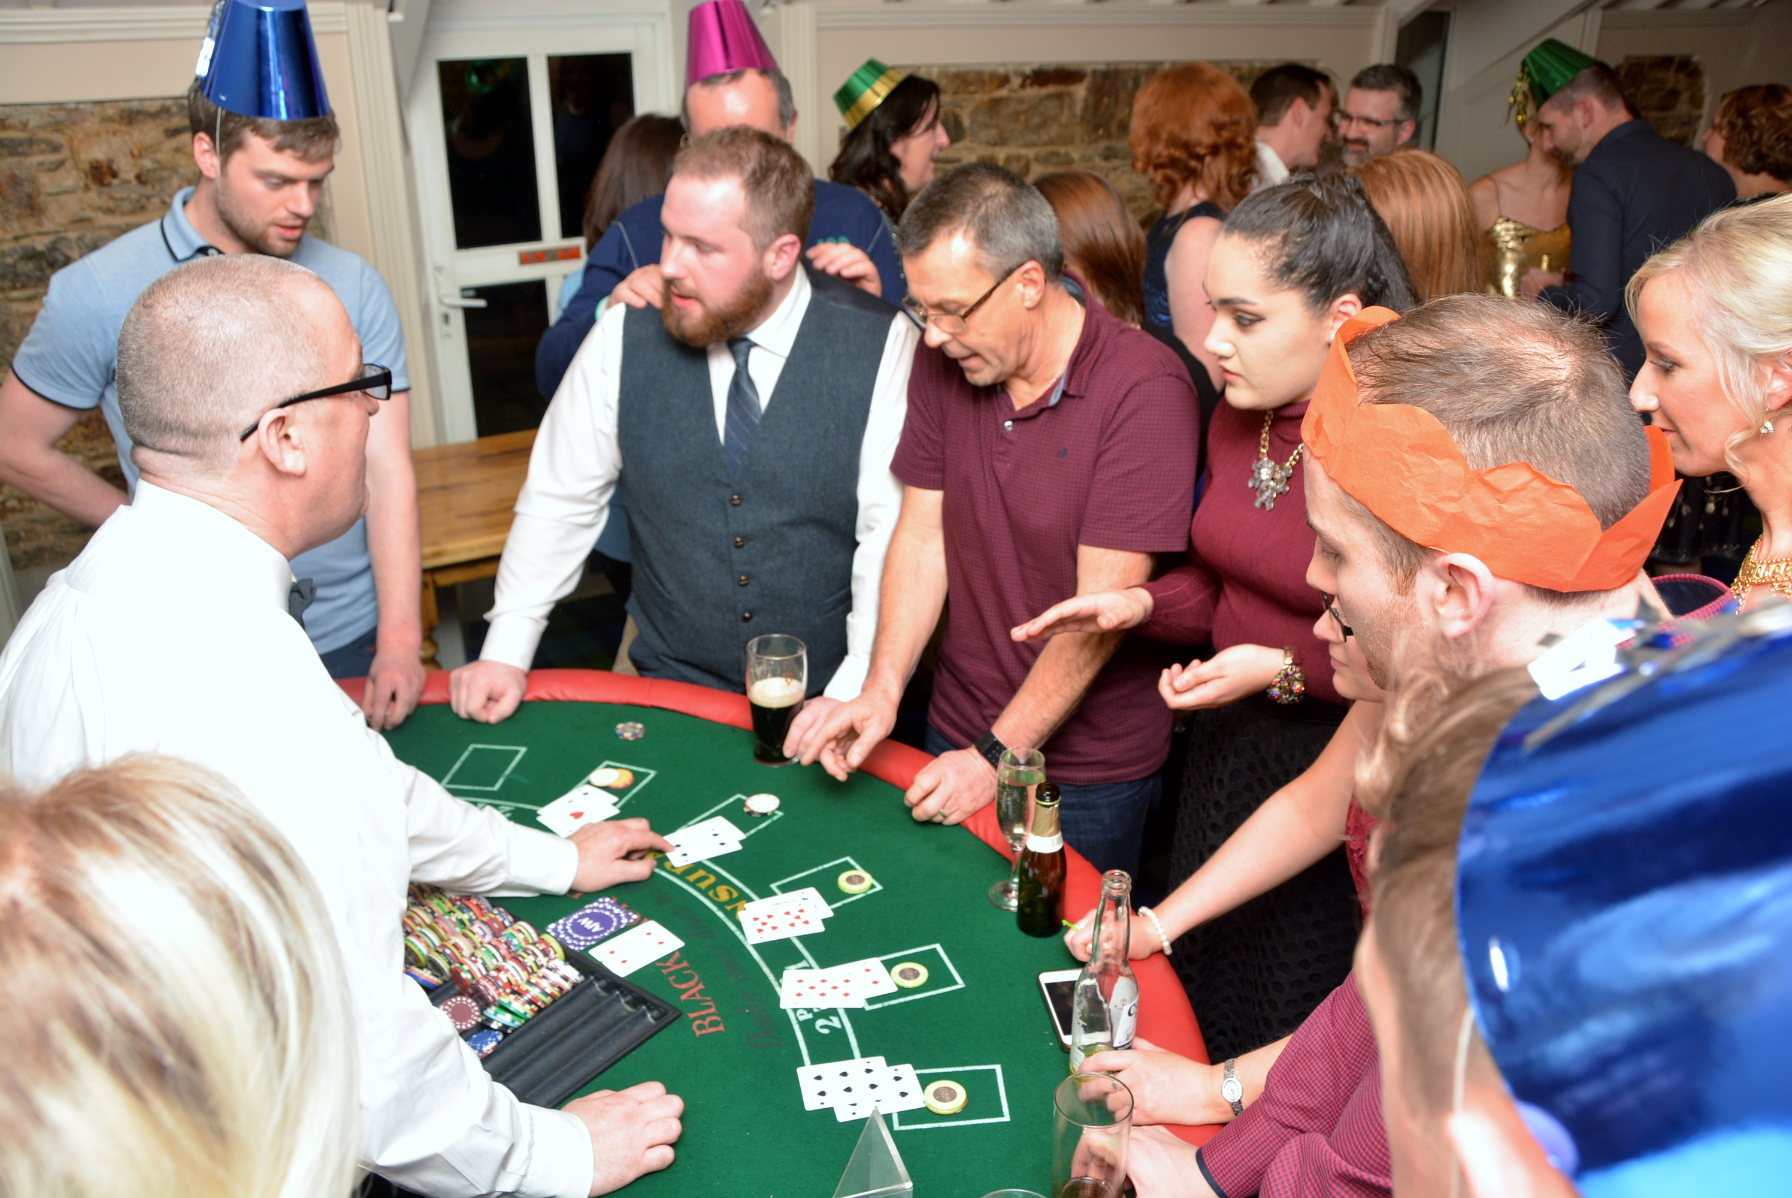
Sports and Social Events

Slide 27








Corporate Social Responsibility
SE2 has sponsored the following events:
We also donate thousands of euro each year to local and national charities:
Notes:
Sponsors
Winterval
Waterford Harvest Festival
Waterford Viking Marathon
Tramore Promenade Festival
Donate to:
Irish Cancer Society
Solas Centre
Focus Ireland
Waterford Hospice

Slide 28
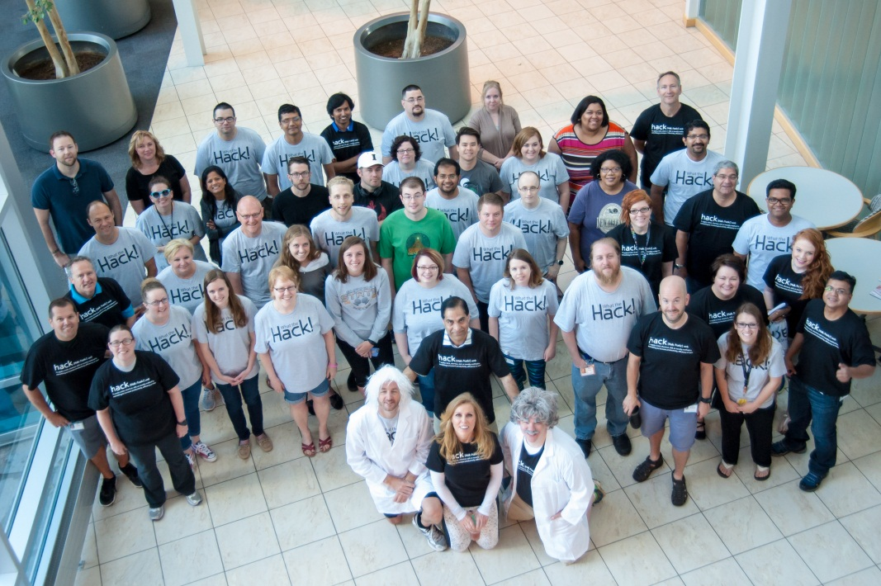
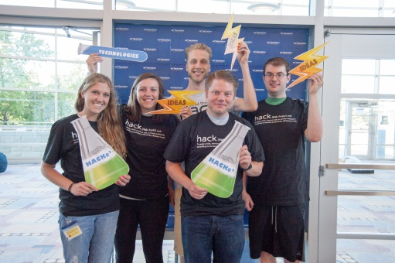
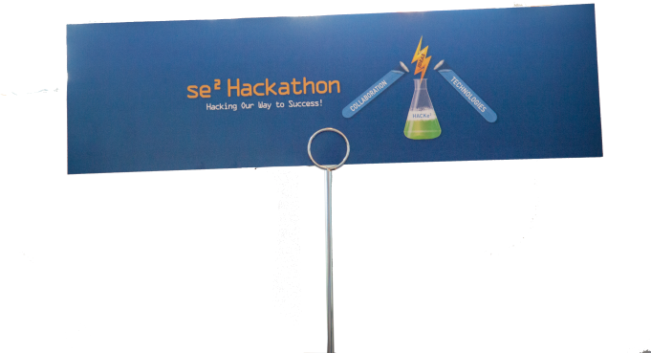
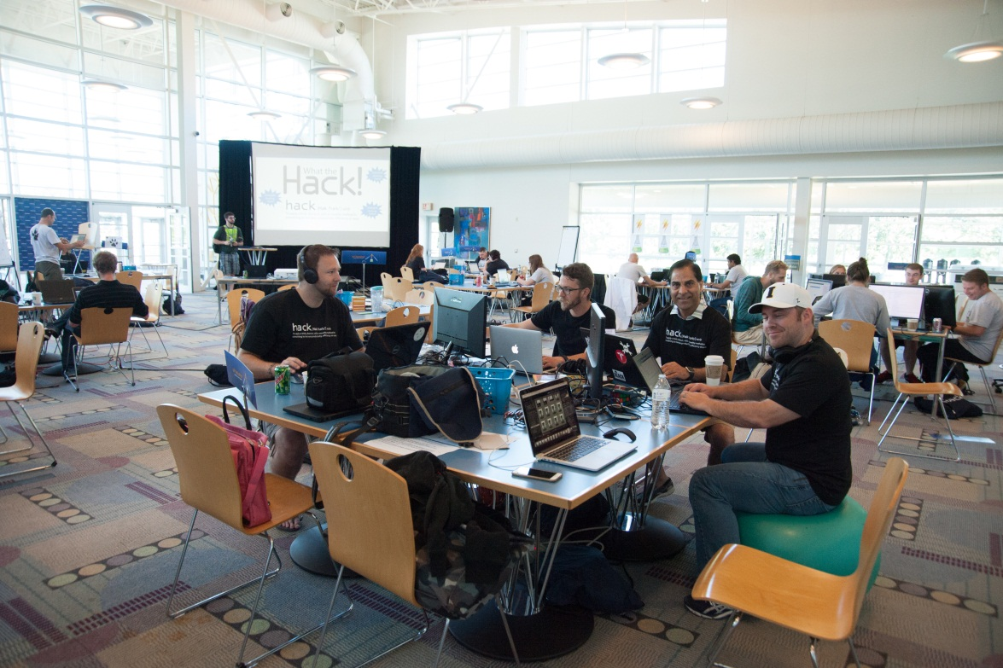
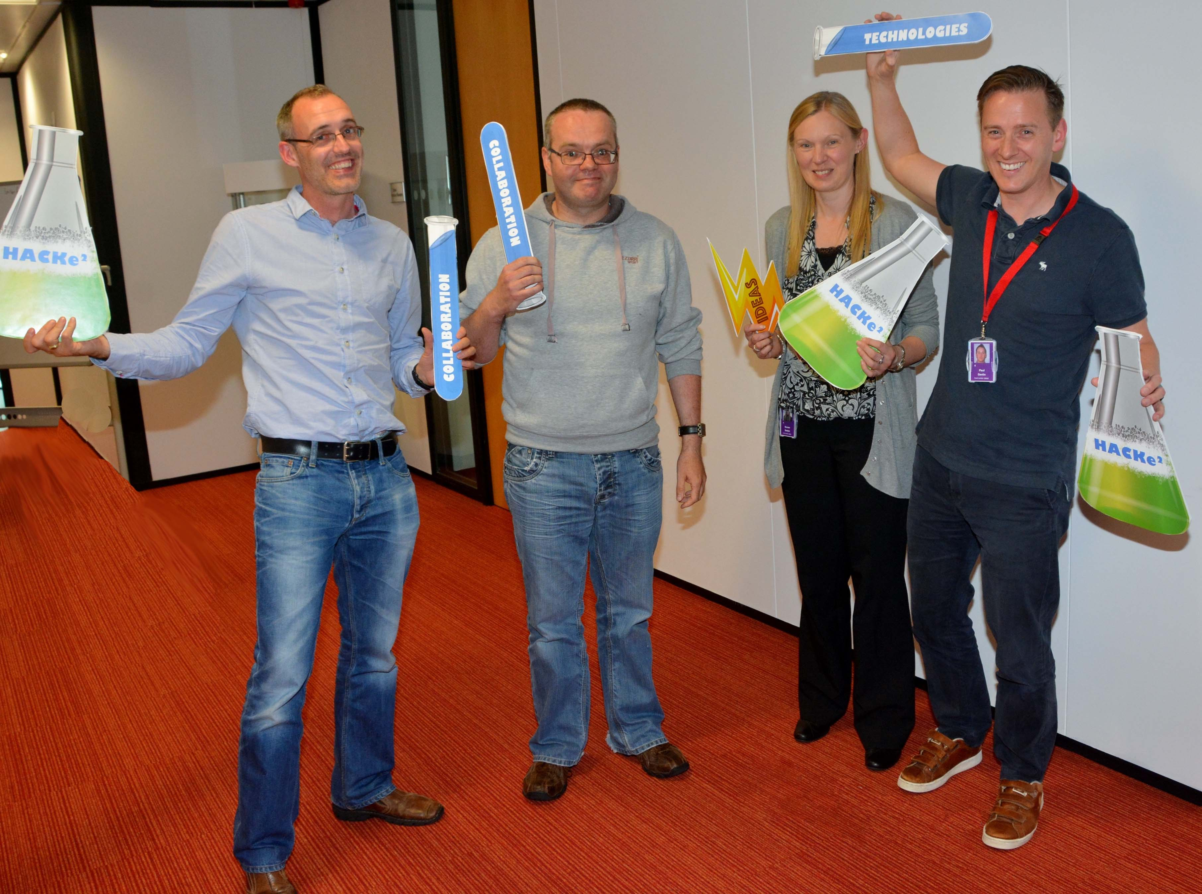
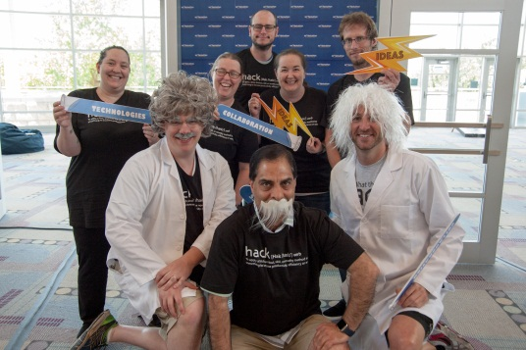
SE2 Hackathon
Notes:
Prizes : Ipads, I watches
What is a hackathon: It is a fun, energizing contest where participants or teams engage in collaborative computer programing with little or no restriction on what can be created. Some hackathons are intended simply for educational or social purposes but in many cases the goal is to create usable software or products. Many of the most innovative companies in the world regularly hold hackathons to provide an invigorating environment for their associates to not only generate but execute on ideas in an unconstrained event.
Embracing the innovative nature of hackathons and what they bring to an organization in terms of creativity, collaboration and especially fun is something I am particularly looking forward to. Next week we will begin hosting lunch and learns for associates interested in participating so please watch Yammer for sign-up information.
Note from Vinod below that will hopefully give you an idea of what happened;
We have just concluded our first Hackathon and to say it was a success would be an understatement in every sense of the word. From an event perspective it was tremendous, but the most important aspects of the Hackathon were the ideas, innovation and progressive thought that the diverse and phenomenally talented teams demonstrated.
Words cannot adequately describe how impressive the work that every single one of the teams put into their submissions. We had two teams which worked 30 hours straight with almost no breaks. This was a true global event and the bar was set high by Ireland who presented their work first. Each and every presentation that followed was extraordinary. Each team proved a deep understanding of our business and our goals of predictability, scalability and enhanced customer experience. The hours and hours of work paid off. Every idea presented was a great idea and relevant to our organization. The best prize a hackathon team could receive is to see their dream and ideas become reality.
So in that case…
EVERYONE IS A WINNER!
se² is choosing to implement every idea! That says volumes about this event and se² associates commitment towards innovation. I have personally participated in many Hackathons and have never seen a 100% implementation feasibility on ideas.
If you were unable to witness the presentations, please see below for a brief summary of each hackathon idea!
Team 1 - Trump This!
Team Members: Diarmuid Russell, Mark Davenport, Noreen Sexton, Paul Devlin, Shay Murphy
Idea: dashboard for providing updates on conversion status. Their choice of technology resulted in an easy to read visually vibrant tool.
Team 2 – BeerCats
Team Members: Ethan Fincham, Hannah Windholz, Jesse Johns, Jordan Foutch, Tegan Seitz
Idea: Automatic interface generator that the user can select the data points they want to see and the tool generates an interface on the fly
Team 3 - Geraghty’s Go Getters
Team Members: Carol Lamme, Dan Guenther, Jill Finn, Mark Davenport, Spring Trail
Idea: Mobile app for broker/dealers delivering client account information, chat, push notifications, a submittable new account form, and feedback
Team 4 - Grand master Fast & Furious Four
Team Members: April Stieber, Cemeo Terrell, Cory Shivers, Pam Gordon, Zac Smithhisler
Idea: Our own internal Siri through Natural Language Processing & integration to Automation Anywhere
Team 5 – Hackanonymous
Team Members: Ambrish Patel , Dilip Korvi. Lindsey Carson, Sharla Exum, Tanmohan Shirsat
Idea: se2 Glass - A delivery lifecycle system combining data from OpenAir, TFS, and JIRA into a single, easy to use application. It enables quick, real time access to project health status, analytics, and release management workflow.
Team 6 - Hackee Sack
Team Members: Amanda Blitch, Samantha Jennings
Idea: KNOW is an adaptive learning solution which help to create individualized training programs for associates
Team 7 - Neon Java
Team Members: Jodie Smith, Kelly Scott, Sam Eubank, Taylor Renyer
Idea: "MARTI" is an app that can be used internally to run simple reports and take the load off of the ad hoc team
Team 8 – Painkillers
Team Members: Bobbi Caggianelli, Heather Shaffer, Katrina Shaw (contributor), Matt Puttroff, , Melissa Pyle, Wayne Stallard
Idea: a solution to address a major pain we have in Correspondence. Their solution will automate the validation, increase efficiency and quality of the deliverables
Team 9 - The Wolfpack
Team Members: Cassie Douglas, Dmitry Borysov, Ramaa Vissa, Susan Woodward
Idea: Lively and engaging presentation; True to the Hackathon objective they came up with a simple yet innovative application to address parking problems
Team 10 – 01000110 01010100 01010111
Team Members: Ben Alford, Ben Johnston, Jason Dabney, Sandy Ortiz
Idea: connect2u is a web chat solution which allows client website users to easily connect to a support representative with their computer or mobile device, supports full auditing and will reduce customer hold times and support costs by allowing CSRs to engage multiple customers simultaneously
Team 11 – W.A.R. Machine
Team Members: Courtney Smith, David Sprecker, Jennifer Engle, Joseph McCracken
Idea: one-stop shop application to an agent including a NIGO resolution feature where agents can check the status of business, be notified of any outstanding unmet requirements and allows for real time communication.
As an organization, we need the passion and commitment each of the team demonstrated by stepping forward to take part in the Hackathon and we will be showcasing the work these teams have done. While the Hackathon may have ended, it truly opened a door into the future of se2 and I have asked the teams to continue what they started. After this weekend I am even more convinced we have the brightest minds and best problem solving ability in the industry. While the judges had to make selections for winners, every submission was a winner. The overall scores were very close and after a lot of deliberation judges selected following entries as winners –
1. Team 8
2. Team 1
3. Team 9
The event was not all work and no play… the 30 hours flew by as we had games, great food and lots of SHENNANIGANS as you can see through the attached photos!
The organization invites all associates, regardless of the area in which you work, to keep dreaming and help se² innovate. We will be communicating next steps soon and let us keep collaborating as we implement these ideas to help se² be the industry leader in Life & Annuity.

Slide 29
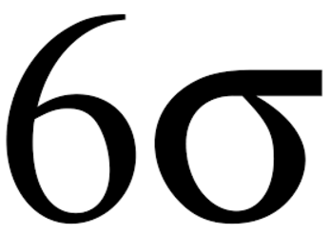

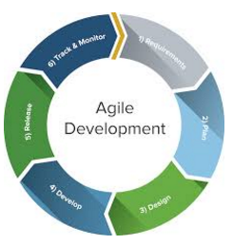
Learning and Development Events
We encourage personal and professional development through:
Lunch and Learns
Six Sigma
Agile
LOMA
Angular JS
MS Visual Studio

Slide 30

Industry Certifications
We work with Skillnet to source:
Advanced SQL
Practical Project Management
PMP
Certified Scrum Master

Slide 31

Further Education with WIT
SE2 works closely with WIT ensuring that modules are relevant and meet the demands of our business and ever changing technologies
Many of our employees have completed/are currently completing:
MSc in Computing in Enterprise Software Systems
HDip in Computer Science
HDip in Business Systems Analysis

Slide 32
For your Career and Development
Part Time Study Assistance Scheme
SE2 Waterford reimburses 75% of the cost of tuition fees, and provides exam leave days for approved studies undertaken by staff under the company Part Time Study Assistance Scheme.
To qualify for eligibility under the scheme, employees must be employed as a permanent employee and have successfully completed probation.
(A maximum of €4,000 will be reimbursed in any three year period.)

Slide 33
QUESTIONS

